Slide 1
Automobile Market Analysis
Mentor: Munna Pandey
submitted by: S. Pratheek
Wave number:4777
Batch Number:da374S37

Slide 2
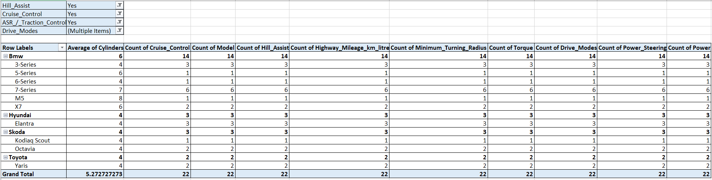
Sprint 6
Identify the adventurous car.
Interpretation
BMW 7series is good foe adventurous car because it has all features which are required like transaction control, hill assist ,cruise control ,power ,ground clearance, ,safety features etc. The above visualization visualizes clearly that 7 series is good for adventurous car by considering all features.

Slide 3
Display relationship between:
a)Displacement and city mileage
Interpretation
It is a negative correlation withcorrelation
Coefficient of -5.8884
b)Mileage and Fuel tank capacity
Interpretation
It is a negative correlation withcorrelation
Coefficient of -0.64167

Slide 4
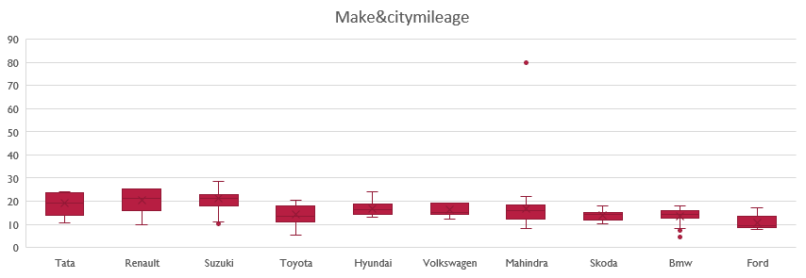
Compare Mileages of cars produced by all manufactures identify outliers
Interpretation:
From above boxplot between car manufactures and city mileage we can easily identify the outlier only one outlier is present Mahindra = 80 it is the outlier

Slide 5
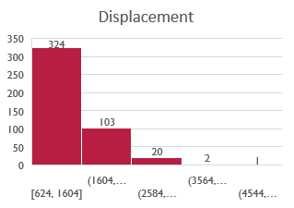
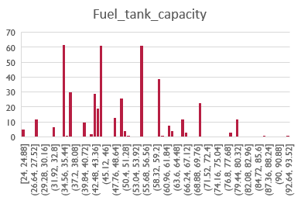
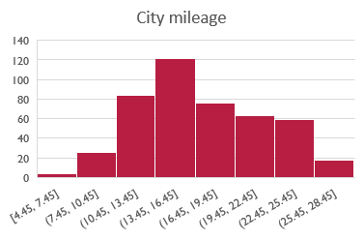
Identify outliers using histogram and remove the outlier's
With Outliers
Displacement( City mileage Fuel tank capacity
Interpretation:
From above histogram visualization the outliers are;
87 and 93 in fuel tank capacity and 4395,4461,4951 in displacement no outliers in city mileage

Slide 6
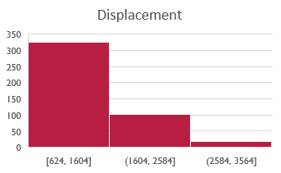
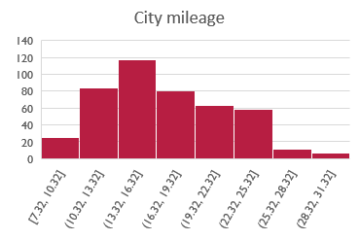
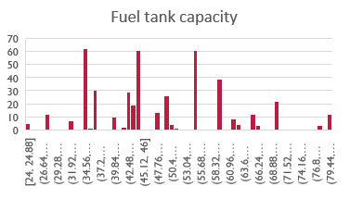
Without outliers
Without Outliers
Displacement City mileage Fuel tank capacity
Interpretation:
The above histogram represent data of displacement ,city mileage,Fuel tank capacity without any missing values and outliers

Slide 7
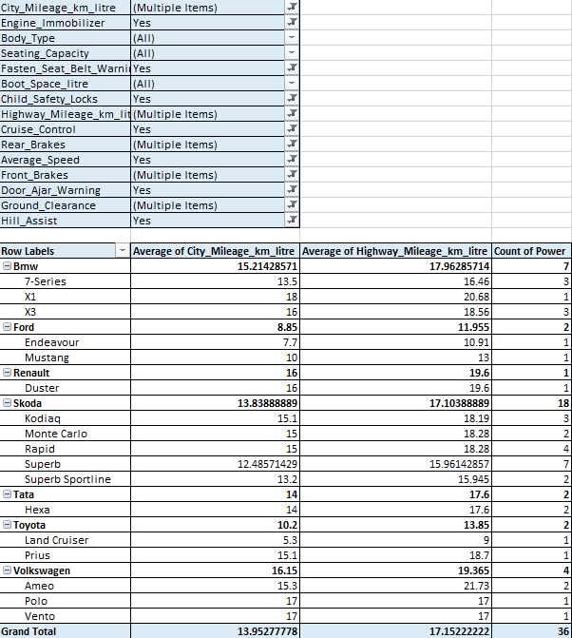
Identify potential competitors for the two type of competitors Compact and famil
Interpretation:
From pivot table and graph under required conditions the ameo,polo,duster,skoda rapid competitors for compact car bmw x1,x3skoda carlo ,vento are competitors for family car

Slide 8
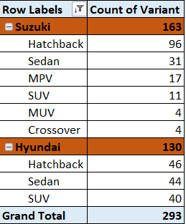
Sprint 7
Identify top 2 car manufactures who offer widest range of car variants
Interpretation:
By above pivot table and bar graph the top 2 car manufactures withwidest range of car variants are Suzuki and Hyundai

Slide 9


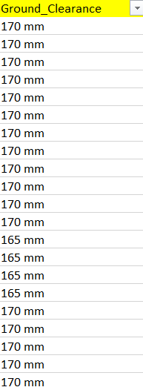
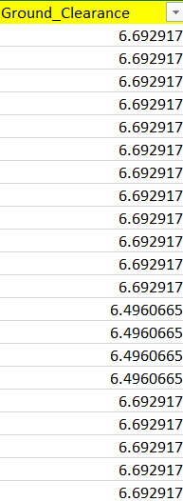
Convert categorical to numerical Standardize the values
Interpretation:
The above fuel system is converted to numerical (injection = 4) and fuel type(CNG=1,PETROL=2,DISEL=3) and we have standardize the values like above ground clearance.

Slide 10
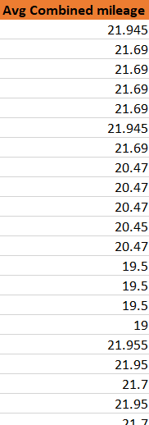

Calculate Additional fuel efficiency matric
Avg combined mileage Distance
Interpretation:
Avg combined milage is calculated by average of highway and city mileage and distance is calculated by multiplying avg combined mileage with fuel capacity.

Slide 11
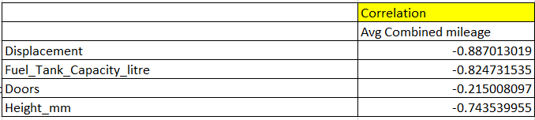
Analyze the driving pattern
Distance and fuel efficiency correlation matric fuel efficiency & other columns
Interpretation:
Above are scatter plots and the correlation matric which analyze the relation of fuel with other
column

Slide 12
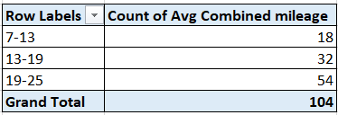
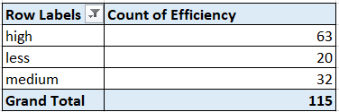
Group cars on basis of efficiency high,low, medium
a b
Interpretation:
a)Above by using pivot table efficiency as been grouped into high ,medium ,low.
b)By pivot table analyzed the distribution the count of each grouped category.
c)The common characteristics of cars high efficiency are cylinders ,engine, power etc.

Slide 13
Display how fuel tank capacity depend on mileage and displacement &correlation coefficient
Interpretation:
Above plot display the relation between fuel and city mileage(negative correlation) , fuel and displacement (positively correlation)fuel&city mileage(-0.641668)fuel&displacement(0.7850968)

Slide 14
Summary
Sprint6(task1-3):By using car data the top 10 cars with respect to displacement,mileage the most common brands are Suzuki,mahindra,toyota and suzuki,hyundai,tata have high number in manufacturing the hatchbags body type.
Task(4-7):By using boxplot outlier is identified in cars with respect to mileage (Mahindra=80).The relationships between displacement&mileage(negative)and mileage&tank capacity(negative). From pivot by considering the attributes identified the best adventurous car bmw 7 series and family car hyundai elantra and bmw 7 series
Task(8-11)By pivot table cars it is identified that like polo,rapid competitors for compact and bmwx1,carlo for family also identified missing values in displacement,fuel tankcapacityusing histogram graph and removed them by filter method to clean data also identified the top 3 cars manufactures in hatchbags,sedans,xuv’s .
Sprint7
The sprint 7 is about project analysis :
In this we have calculated the top with high number of variants like hyundai and Suzuki and measure dispersion to understand the spread of data

Slide 15
Summary and conclusion
Identified the correlationship between fuel tank capacity mileage to understand relation of columns in data. Data processing checked any missing are present in our data and try to remove them using filtering and making data free of missing values changing the categorial data to numerical data for better ananlysis, standardizing units and caculated new columns for like fuel efficiency to know data better and better usage.
On basis of fuel efficiency the cars are grouped in high,low,moderate and identified the features of cars which have high efficiency bases of fuel and to perform this the data used is outlier free and no missing values and the final our high efficiency cars are identified
CONCULSION:
From the analysis of project I can conclude the to preform a data analysis the data should be free of outliers and null values
Data should be clearly understood and it attributes relations like data cleaning and understand the pattern correctly.
From above data analysis high efficiency cars in market is found . So, they can be referred .

